Slide 1
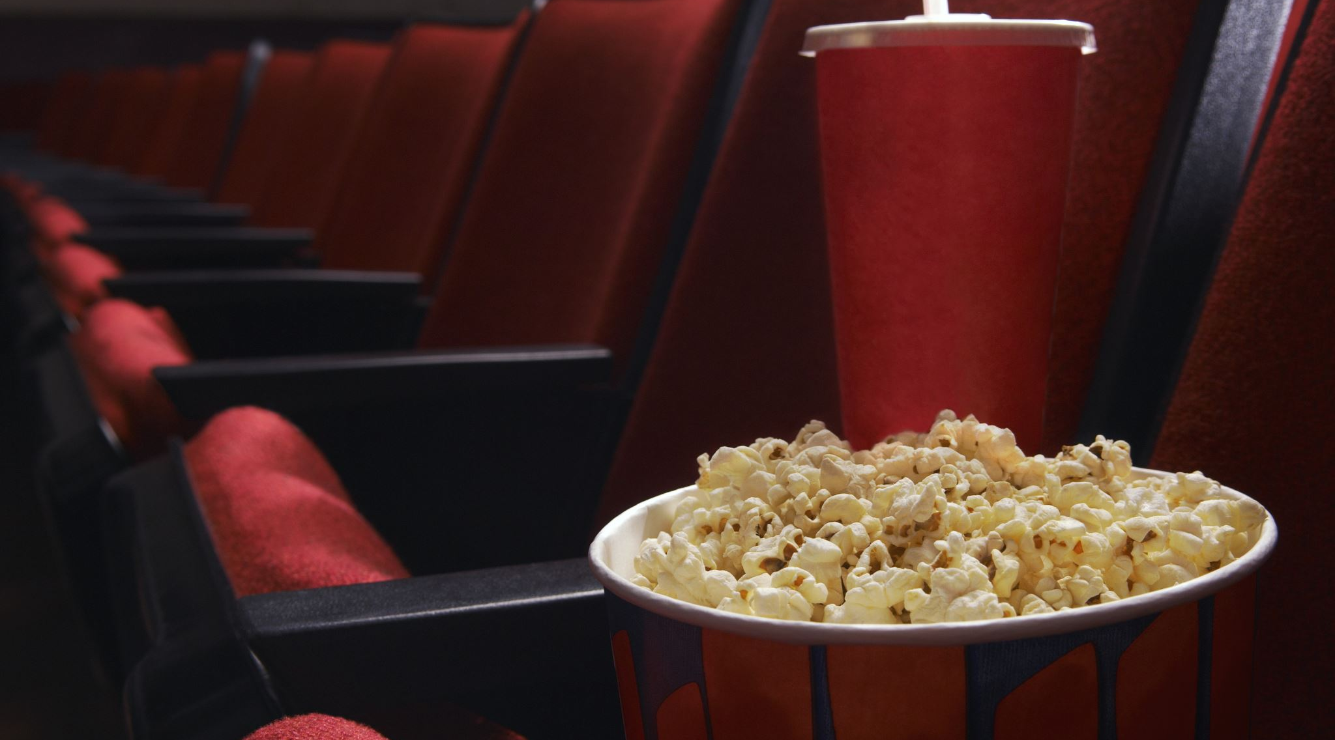
Exploring Movie Recommender
Where Data & Algorithms Meet Popcorn

Slide 2
Introduction to Movie Recommenders
Content-based:
Analyzes item and user profiles for similar suggestions.
Collaborative filtering:
Finds patterns for recommendations based on similarities.
Knowledge-based:
Recommends using rules and domain knowledge.
Popularity-based:
Relies on overall popularity.

Slide 3
Building a Content-Based Recommender
This project centers on constructing a collaborative filtering-based recommender engine tailored for movies.
Users provide a movie title, and recommendations are generated based on similarities in certain features, aiming to offer personalized suggestions.
Let's explore and manipulate movie content to build it!

Slide 4
Data Selection and Formatting

Slide 5

Non-Commercial Databases
Title Basics Dataset: fundamental information about the content in IMDb, such as title, genre, and release year.
Crew Dataset: details about the crew involved in a certain movie production, including directors, writers, and other personnel.
People Dataset: information about individuals in the movie industry, such as their professions and known works.
Ratings Dataset: ratings provided by users, aiding in understanding movie popularity.

Slide 6
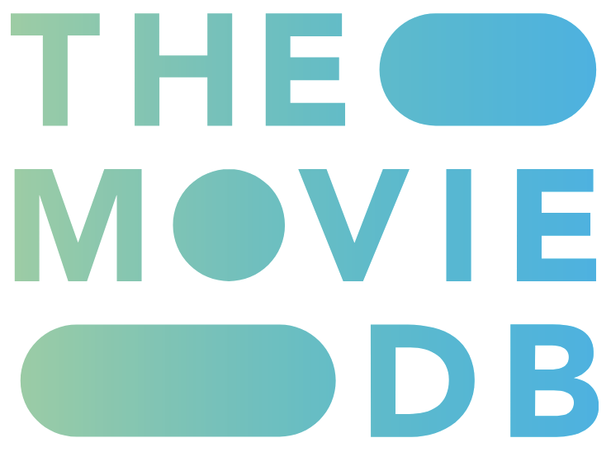
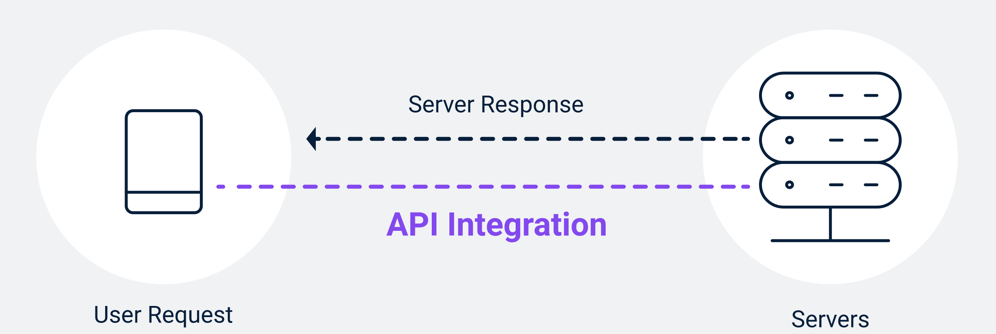
TMDB API provides a vast repository of movie-related information. Allows access details such as movie title, genre, cast, crew, and synopsis.
The algorithm sends a query based on the user input, typically the movie title, to the TMDB database. The API returns details of the found responses, which is incorporated into the recommender system.

Slide 7
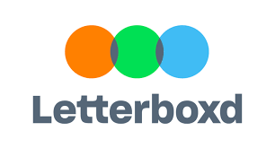
Web Scrapping Reviews
The recommender also shows top movie reviews to highlight popular opinions on recommended movies.
The algorithm is utilizing a scraper class created for Letterboxd website. The scraper class is designed to work with TMDB IDs as input.
Reviews are scraped in real-time, providing users with up-to-date feedback on recommended movies.

Slide 8
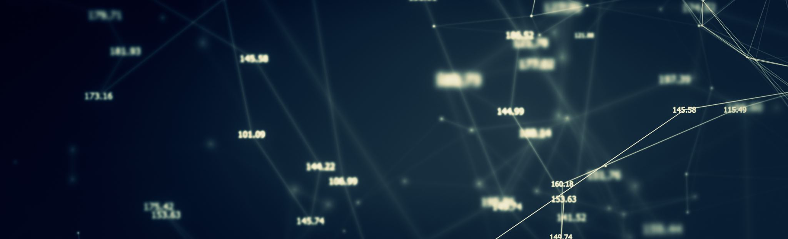
Final Dataset
To manage its size, the movie data underwent refinement:
Empty cells were filled using API calls, while entries with no results from TMDB were dropped.
Values were formatted to convert IDs into names and titles.
Outliers were identified and checked for logical consistency.
Final Data Shape: The dataset now consists of 37,841 entries with 15 attributes.

Slide 9
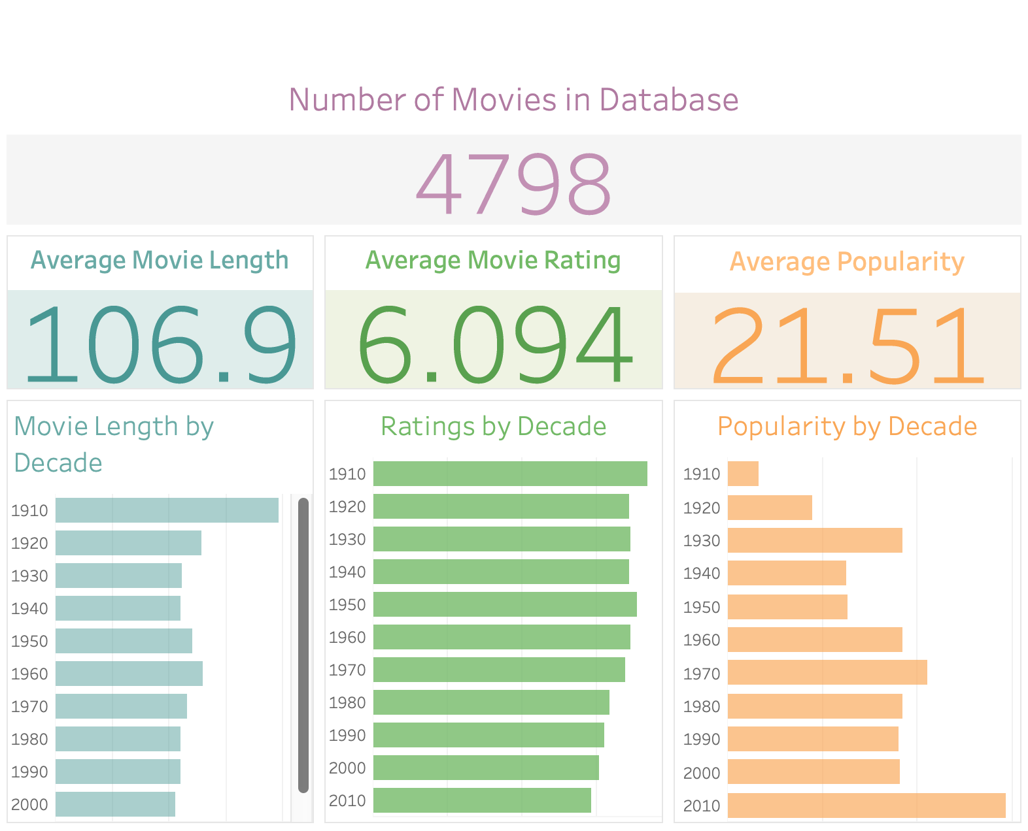
About the data…
Numerical Data:
Movie Length
Popularity
Rating
Categorical Data:
Genres
Textual Data:
Keywords
Overviews
Cast
Crew
Production Countries
Numerical Data Details

Slide 10
Model Building
Natural Language Processing & Matrix Similarity

Slide 11

Choosing a Model
KNN Neighbors
Proximity-based recommendation by identifying neighbors in feature space.
Vector Similarity
Comparison of items or users using vector representations.
Matrix Factorization
Decomposition of interaction matrix to capture latent factors.
Deep Learning
Utilization of neural networks for learning intricate patterns.
Association Rule Mining
Discovery of item associations in transactional data.
Hybrid Recommender Systems
Integration of diverse methods for improved recommendation accuracy and diversity.

Slide 12
Similar but in which way?
Euclidean Distance: Measures the straight-line distance between two points; utilized in algorithms like k-NN for proximity-based recommendation.
Cosine Similarity: Calculates the cosine of the angle between two vectors, indicating directional similarity regardless of magnitude; commonly employed in various algorithms for similarity assessment.
Hamming Distance: Determines the number of differing positions between two strings of equal length; used in similarity search for binary data or categorical variables.

Slide 13
Feature Engineering
For textual data, (overview, keywords, production details etc.) I used Lemmatization, Stemming and Tokenization.
Then I transformed the textual data into mathematical vectors using TF-IDF.
I chose Multi-Label Binarizer for genre encoding because MLB is ideal for multiple labels in each data point. In the context of genres for movies, a movie can belong to multiple genres (e.g., action, adventure, sci-fi).
For numerical features such as movie duration, ratings, and release date, MinMax Scaler was utilized to scale the values appropriately.

Slide 14
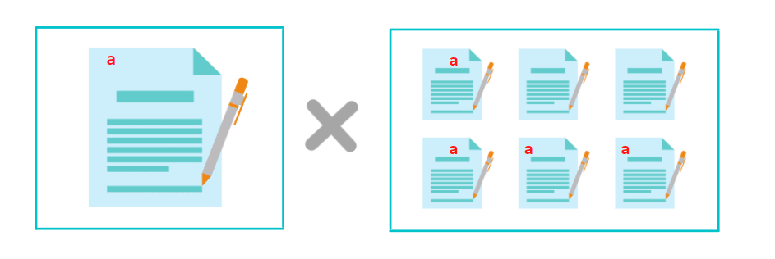
TF-IDF? WT#*?
TF-IDF, a nifty technique in NLP, acts as a word importance map.
It shines a spotlight on terms that are rare gems within a document yet abundant in the larger corpus.
TF-IDF is employed in recommenders to spotlight unique words in items or user preferences, guiding the system to suggest items that match those distinctive features, thus enhancing recommendation relevance.
Term Frequency
1 / Document Frequency
Notes:
by analyzing how frequently words appear in a document compared to their occurrence across the entire text collection (in this context, all movie descriptions).

Slide 15
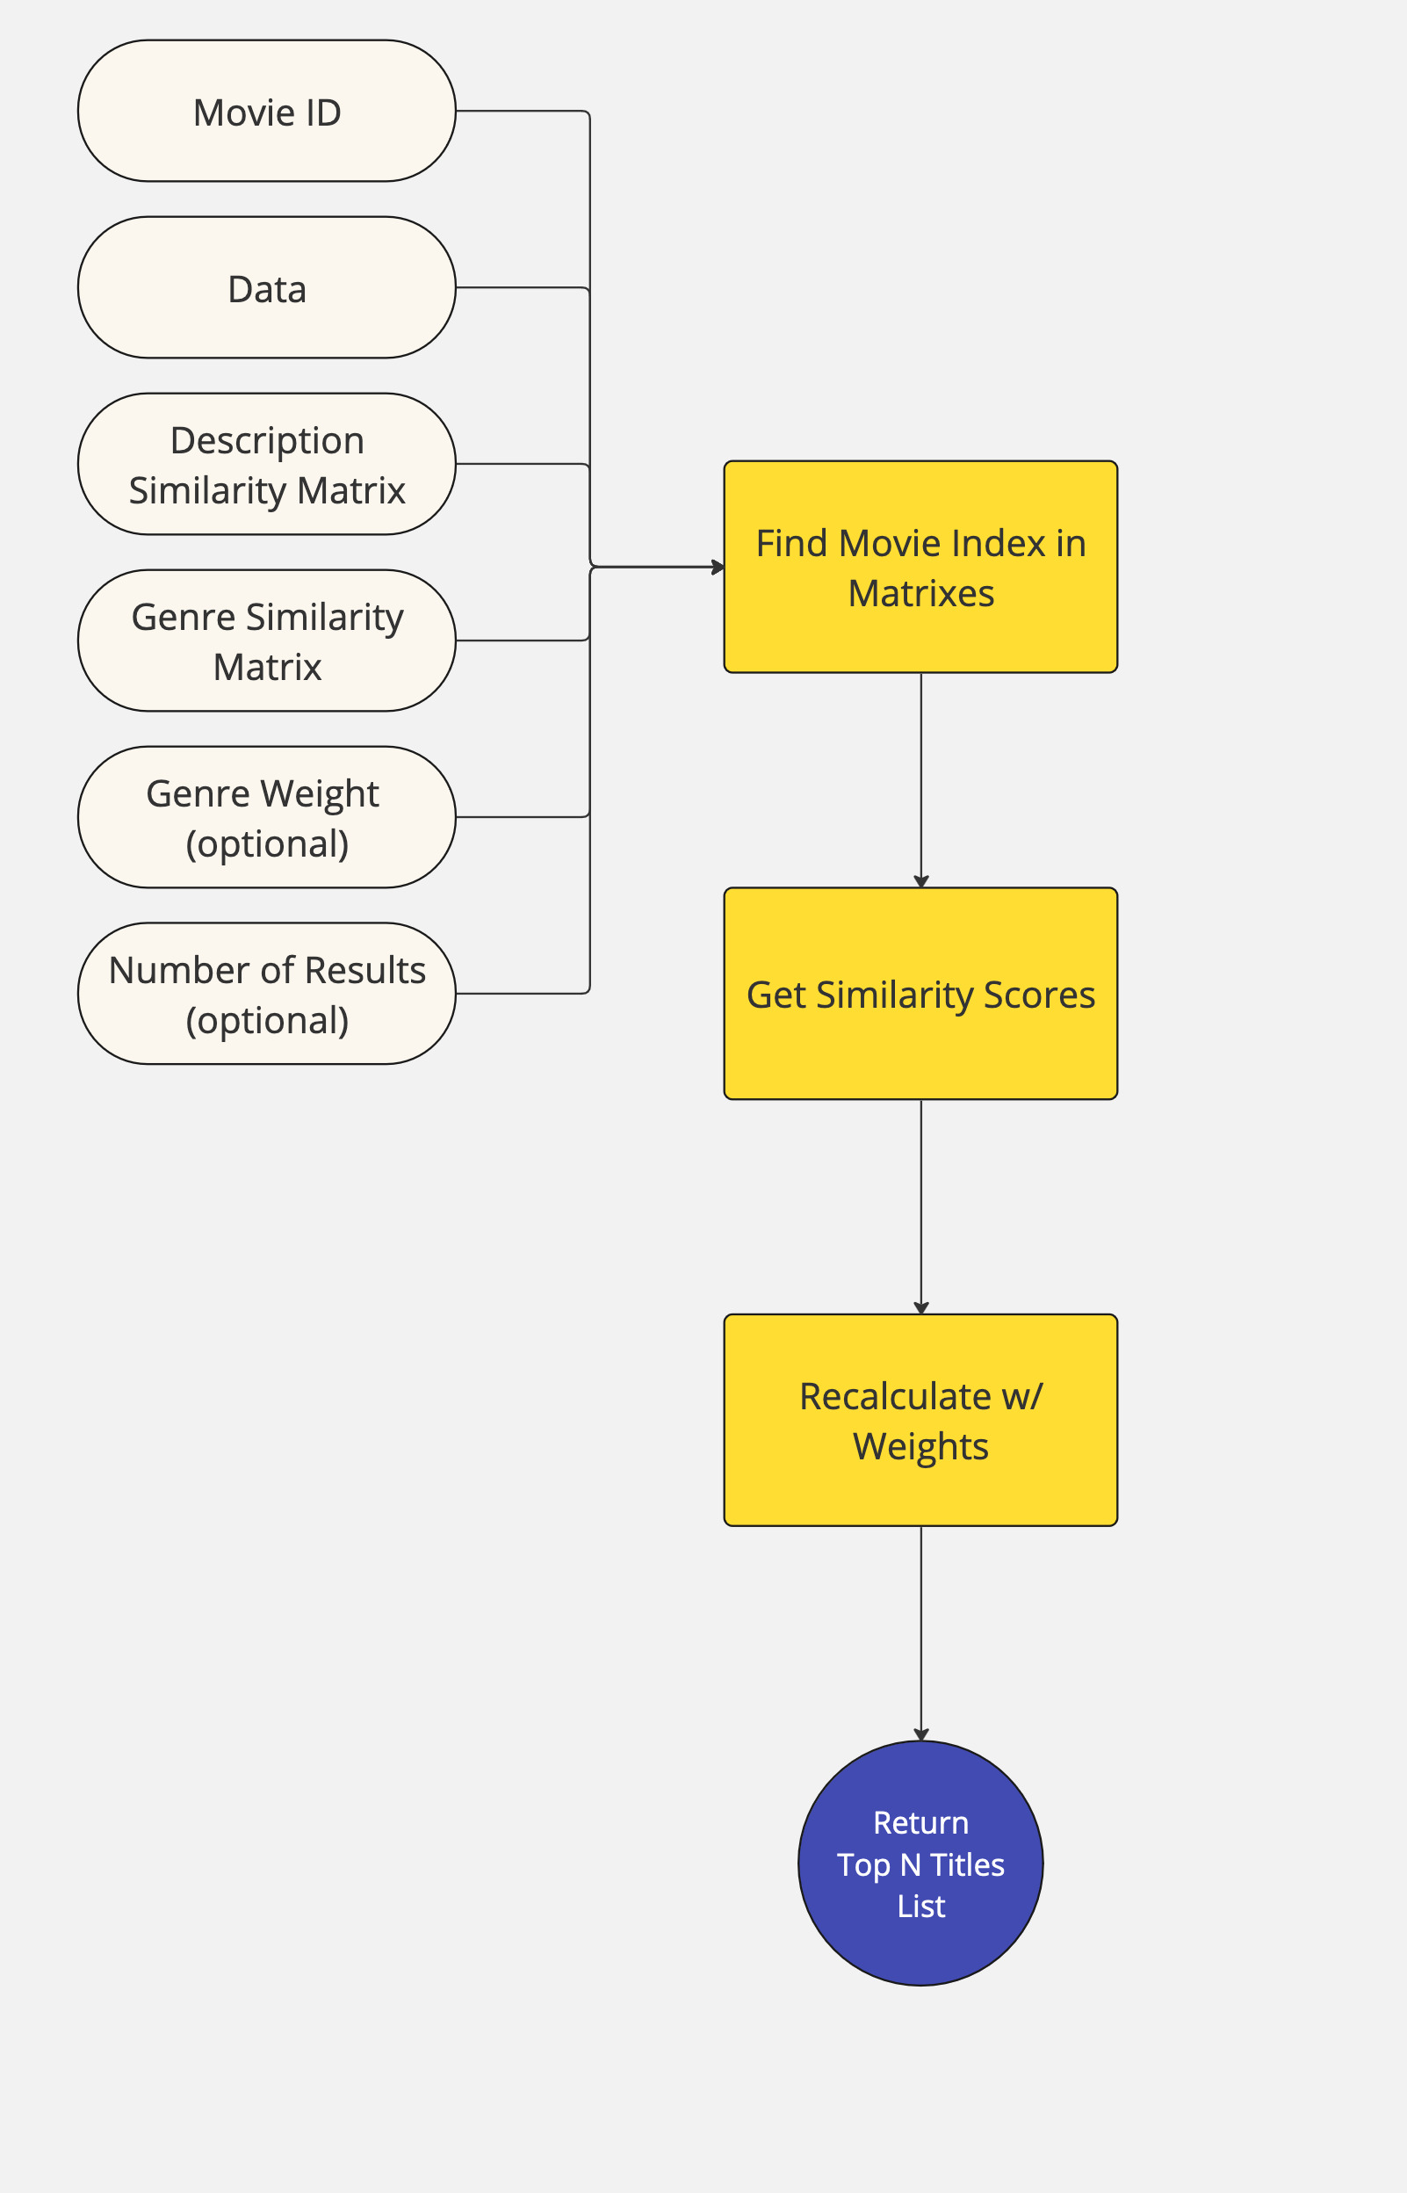
Final Recommender Model
Inputs:
Movie ID: Unique identifier for the movie.
Movie Database: Collection of movie data.
Similarity Matrixes
Genre Weight: Weight to prioritize genre similarity.
Top N: Number of most similar movies to retrieve.
Process:
Model retrieves data and similarity matrices based on the movie ID.
Similarity scores between the user's movie and others are calculated using the pre-computed similarity matrices.
Optional weights can be applied to prioritize certain factors.
The top N most similar movies are identified based on the calculated similarity scores.
Output: List of the N most similar movie titles.

Slide 16
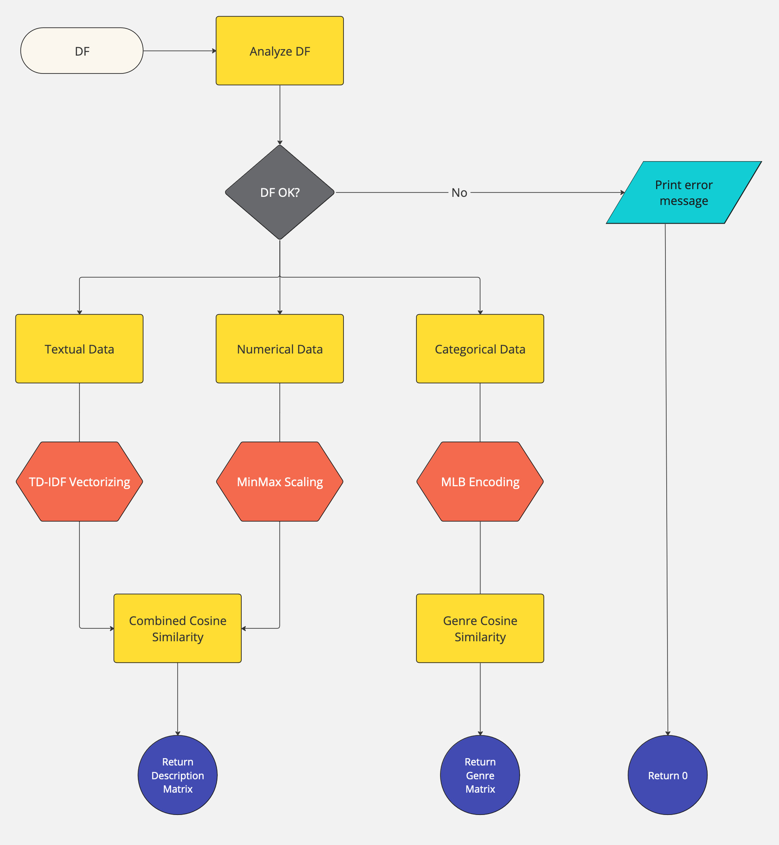
Preprocessing Data
Input:
Movie Database: Collection of movie data.
Process:
Textual Data (TF-IDF Vectorizing): converts textual data into a numerical format
Numerical Data (MinMax Scaling): scales numerical data (e.g., release year) to a common range (often between 0 and 1)
Combined Cosine Similarity: calculates the cosine similarity between each pair of movies using the processed data (textual & numerical).
Categorical Data (MBL Encoding): converts categorical data (e.g., genre) into numerical vectors.
Genre Cosine Similarity: calculates the cosine similarity between movies solely based on their genre data.
Output:
Description Matrix: contains the processed textual data (TF-IDF vectors) for each movie.
Genre Matrix: contains the processed genre data (MLB vectors) for each movie.

Slide 17
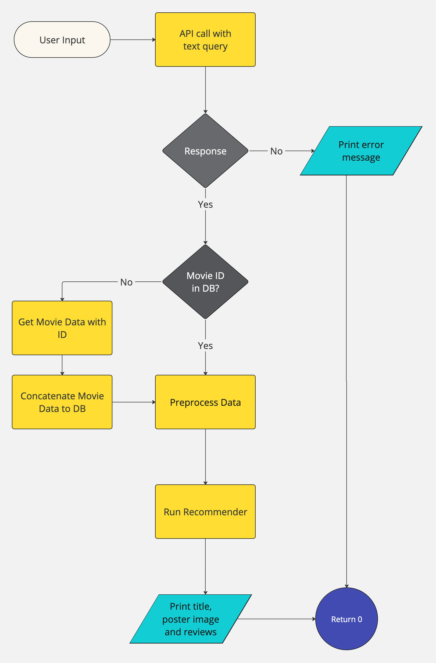
Final Model
Inputs:
Text Query: User-provided movie title.
Process:
Check Movie ID: Verify if the provided movie ID exists in the database.
Handle Cases:
ID not found: Add movie data to database and proceed.
ID found: Proceed to retrieve movie data.
Retrieve Movie Data: Get information associated with the movie ID (title, genre, synopsis, actors, etc.).
Preprocess Data (Optional): Clean and potentially transform retrieved data (text cleaning, stemming/lemmatization).
Run Recommendation Algorithm: Utilize an algorithm (e.g., collaborative filtering, content-based) to generate recommendations based on the movie data and potentially other factors (user history, similarity matrix).
Output: List of recommended movies with titles, posters, and other relevant information.

Slide 18
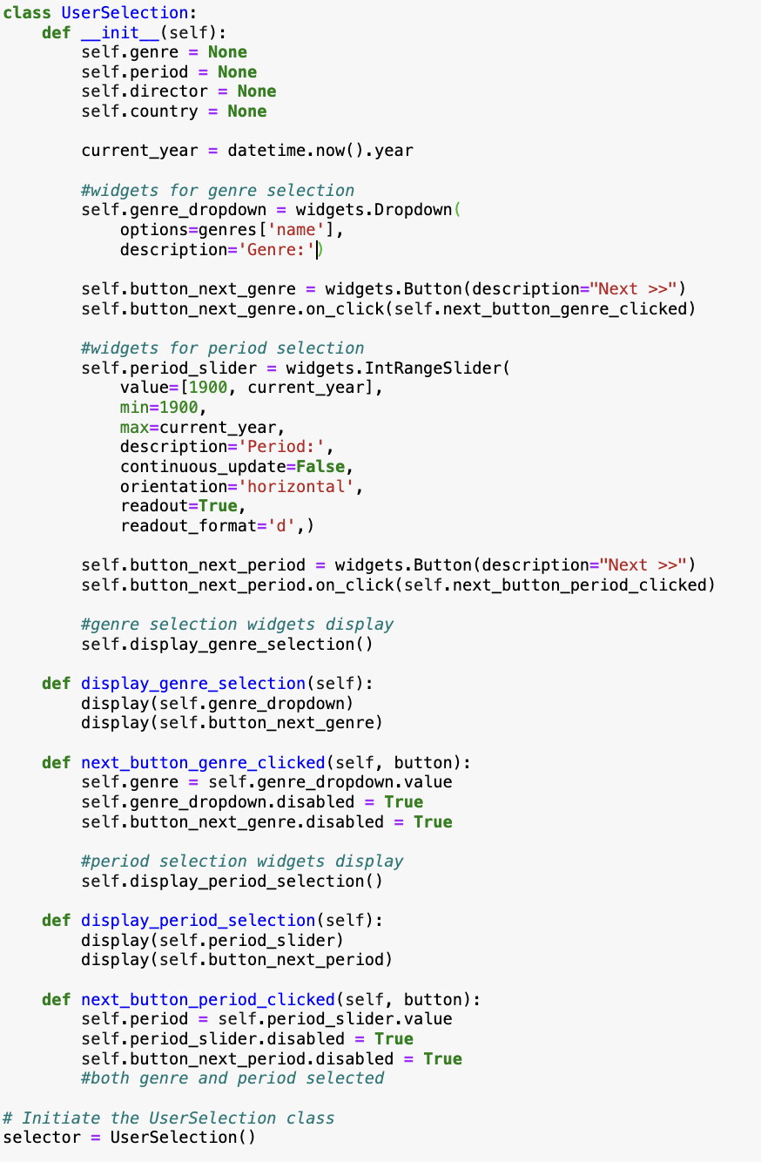
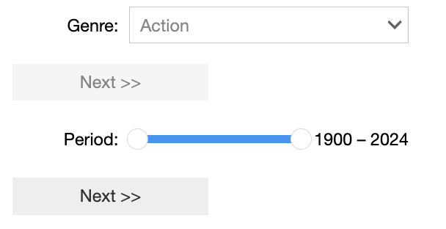
Next Steps
First Drafts
Features to add:
Genre Filter
Period Filter
Director/Producer Filter
Bechdel Test Results
UI/UX improvements:
Ipython Widgets
Streamlit Integration

